Slide 1

Microgrid Control with DQN
Joseph Egan

Slide 2
Microgrids are localized electrical grids
At a minimum they contain:
Consumers/loads (households, businesses, etc.)
Source of power generation (renewable and/or non-renewable)
Energy storage system (typically batteries)
Connection to the main grid
Offers several advantages over regular connection to the grid
Localization means cost of control optimizers are a barrier to entry

Slide 3
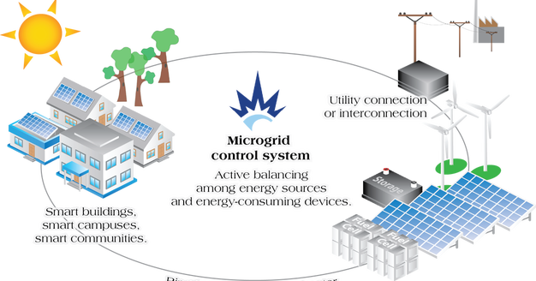

Slide 4
This can be a complicated problem for an agent
There are a few things to optimize, research has been conducted on:
Grid configurations
Coordination of renewable resources to maximize efficiency
Enhancing stability and reliability through optimizing the scheduling of the battery system
Profitability – strategically altering prices, charge states, resource operation to minimize cost

Slide 5
Focusing on battery control and profitability
When the microgrid can’t generate enough power on its own, power must be purchased from the main grid at a higher rate
Proper utilization of the battery resource can mitigate this expense (Problem 1)
Raising and lowering hourly prices can also shift demand to favorable times of the day (Problem 2, more complex)

Slide 6
Using weather and electrical data from the Boston/NE Mass area:

Slide 7
Formulation of the MDP
Reward
Problem 1: net cost of electricity purchased from main grid
Problem 2: revenue from production minus electricity purchased from main grid
States
Battery status, demand, generation, price + forecasts
Actions
Problem 1: charge/discharge battery, buy/sell from main grid
Problem 2: price up/flat/down, charge/discharge battery, buy/sell from main grid

Slide 8
DQN Algorithm
In deep q-learning, make use of a primary and target model
Primary model predicts values for actions to take
Target model provides the ‘true’ values for parameter updates
Target model is periodically updated to match primary model
Replay queues, etc..

Slide 9
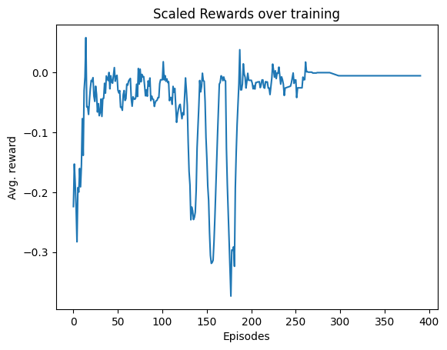
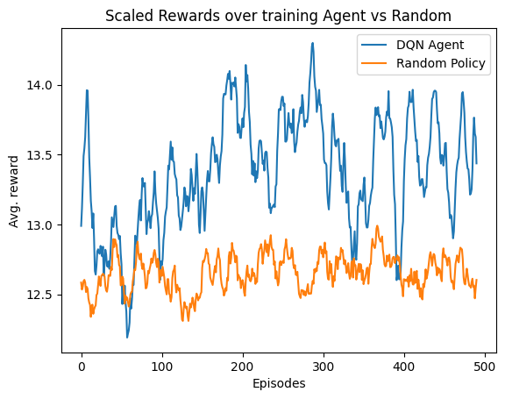
Agents obtain near-optimal policy in Problem 1; Problem 2, less clear
Problem 1
Problem 2
Notes:
Problem 1 – avg reward over 10 days, epsilon terminated at 300 episodes
Problem 2 – avg reward over 10 days, random agent vs DQN agent , epsilon terminated 400 episodes

Slide 10
Drawbacks/Next Steps
Massachusetts weather is highly variable, which leads to high instability in training data for agent, requiring more time to train
Run agents few more times to get smoother results
Analysis on policy

Slide 11
Q&A

